Slide 1
Recipe Sharing App
By Joseph Evans (PL), Met Afework, Talha Qureshi, & Cliff Freeman

Slide 2
Our Idea
Spoonacular
Frontend
Backend
JWT
Swagger
Demonstration
Overview

Slide 3
Our Ideas
1

Slide 4
There were a few ideas we had, but the one that sounded the most appealing was an app for sharing recipes. It allows a given user to look through a selection of communal recipes and save it (or not) to their own recipes page, delete it, and search recipes based on ingredient choices.

Slide 5
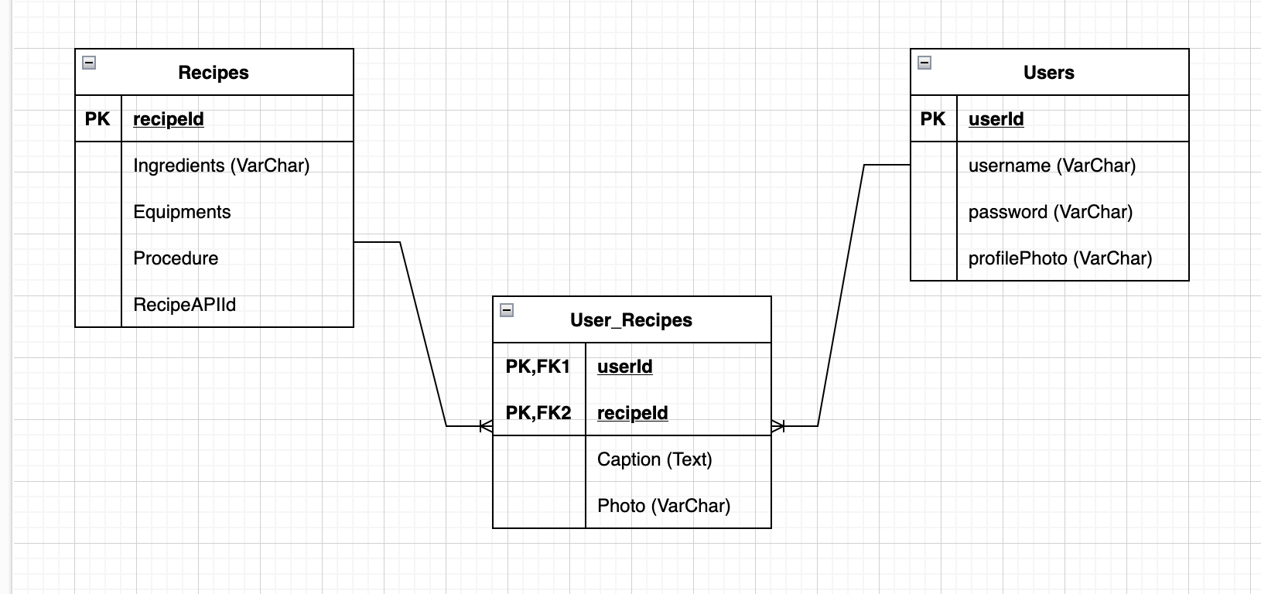
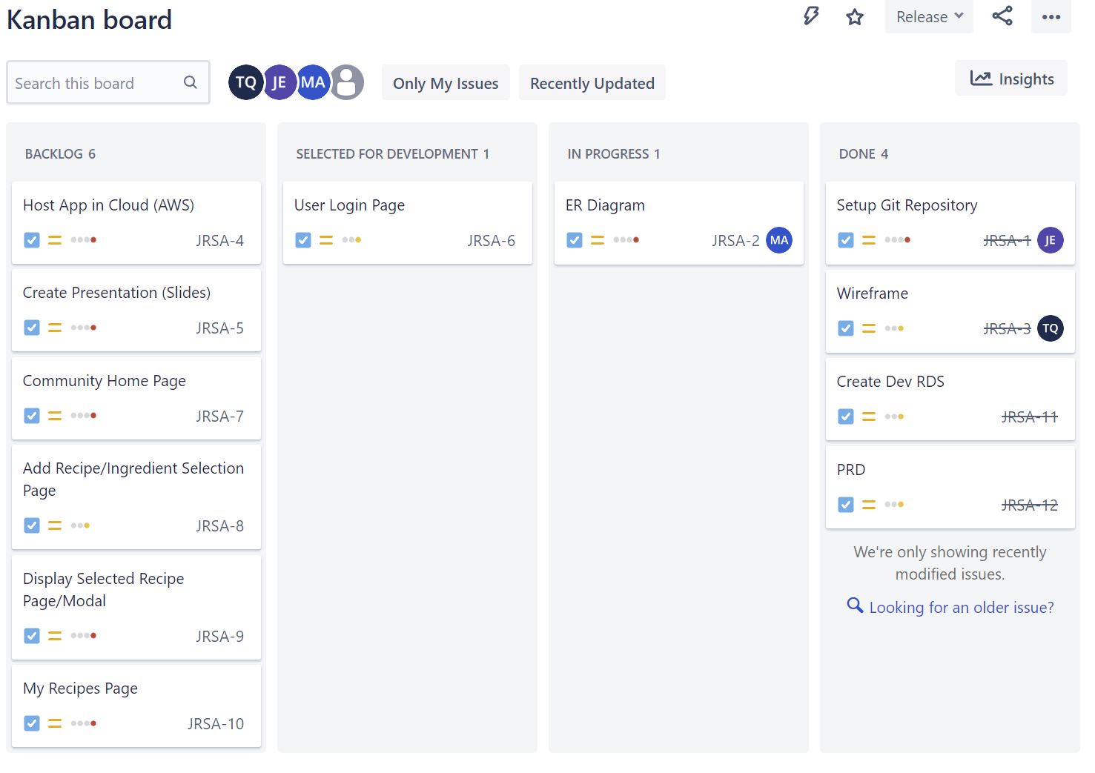
Planning

Slide 6
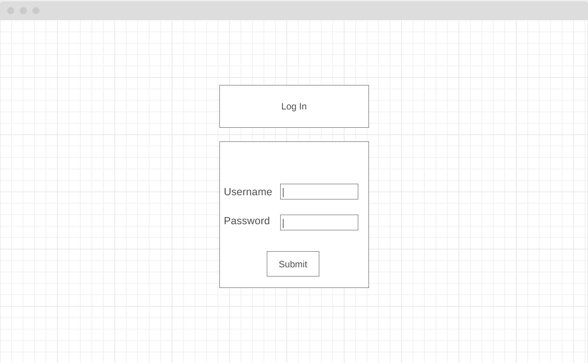
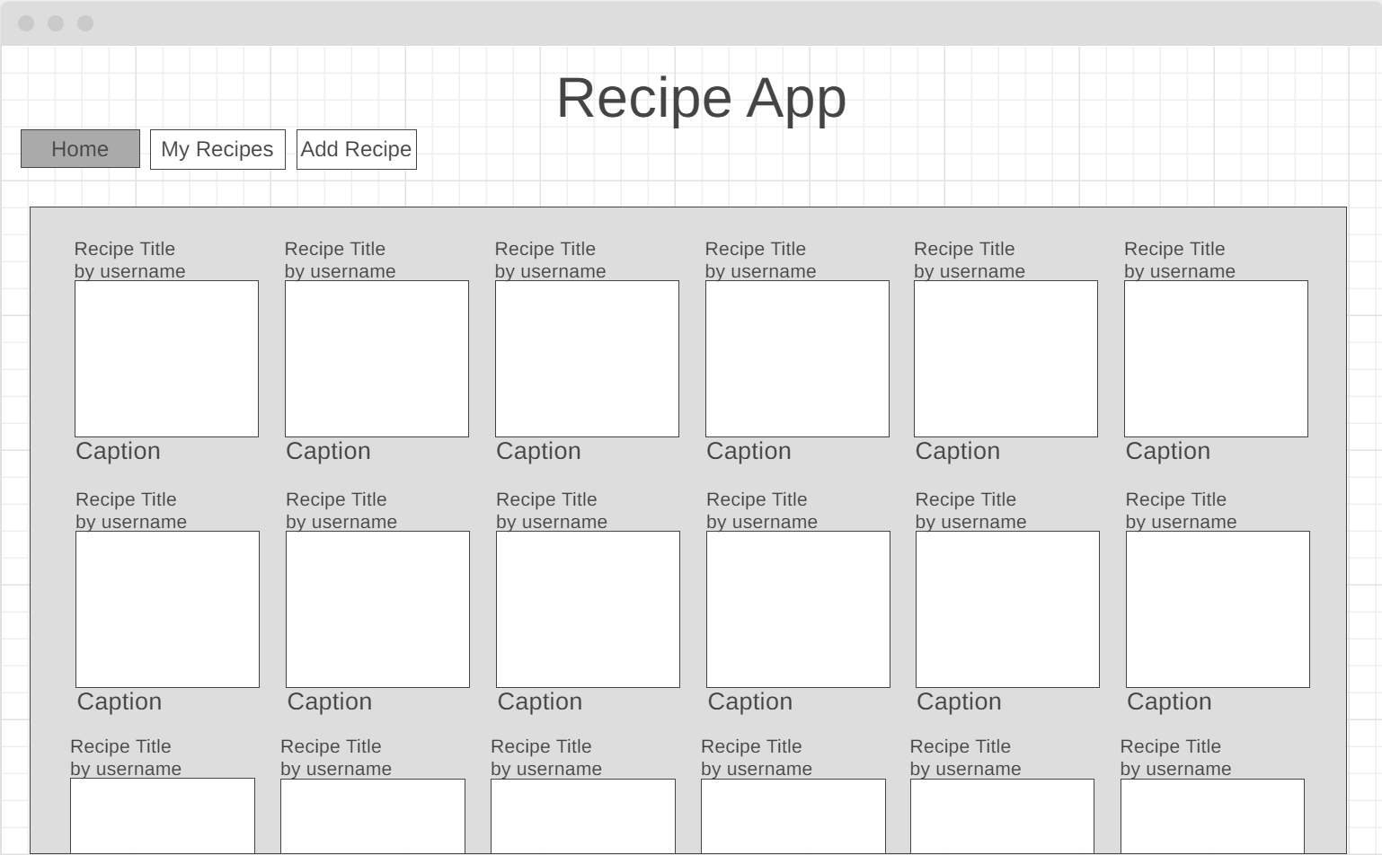
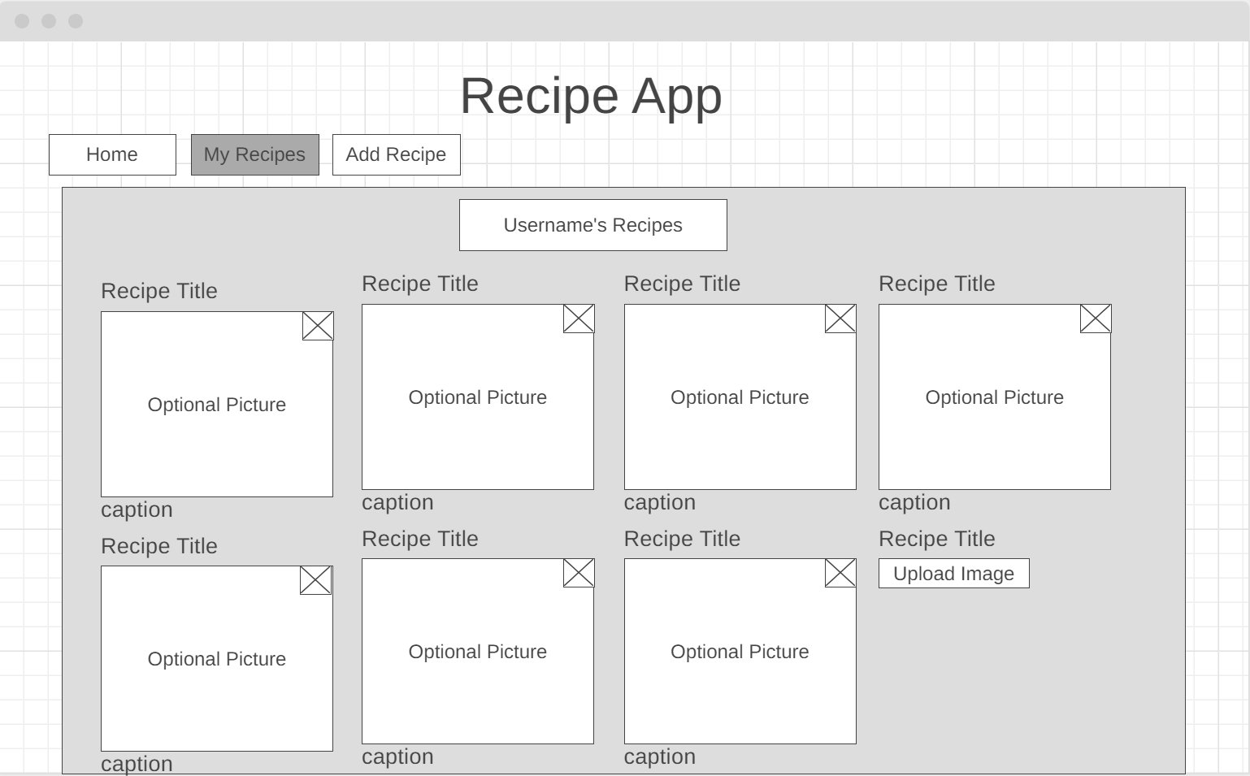
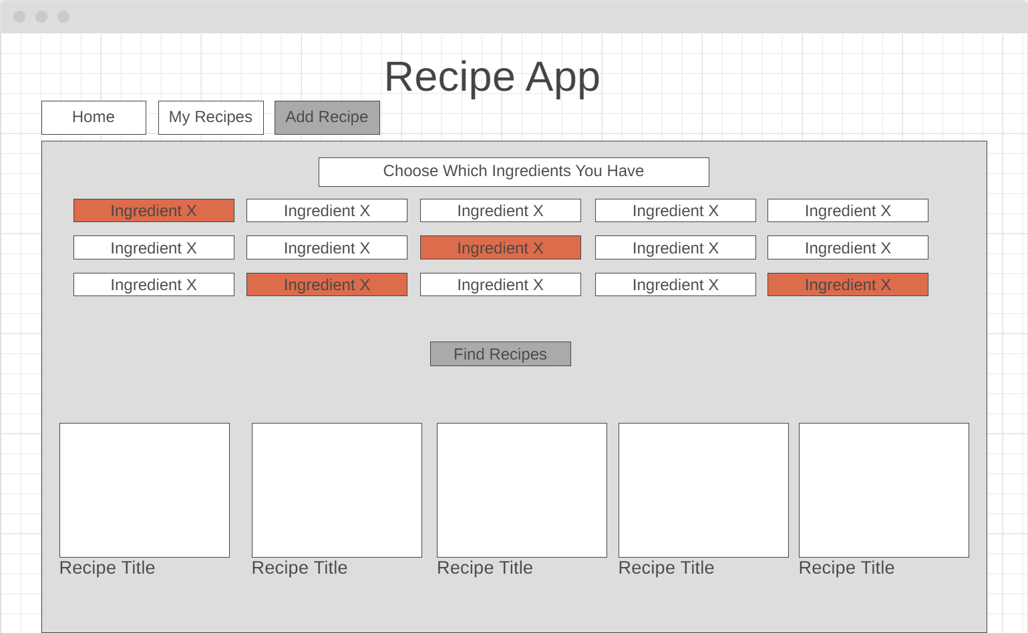
Wireframe

Slide 7


FRONT-END TECHNOLOGIES
We used:
React.js for an easy-to-use UI
Visual Studio Code for creating the API calls, components, and the overall design.
Hosted on public AWS S3 bucket

Slide 8
Spoonacular API
Very powerful
Can search for recipes with given ingredients
Used in conjunction with our custom Spring backend
2

Slide 9


BACK-END TECHNOLOGIES
Eclipse: Managing our Spring Boot backend
MySQL: Database hosted on private RDS
Accessible through our EC2 and through API calls only

Slide 10
JWTs
Not just anyone could use the website without proper authentication. Because of this, we added JSON Web Token functionality for users when they login (and out).

Slide 11
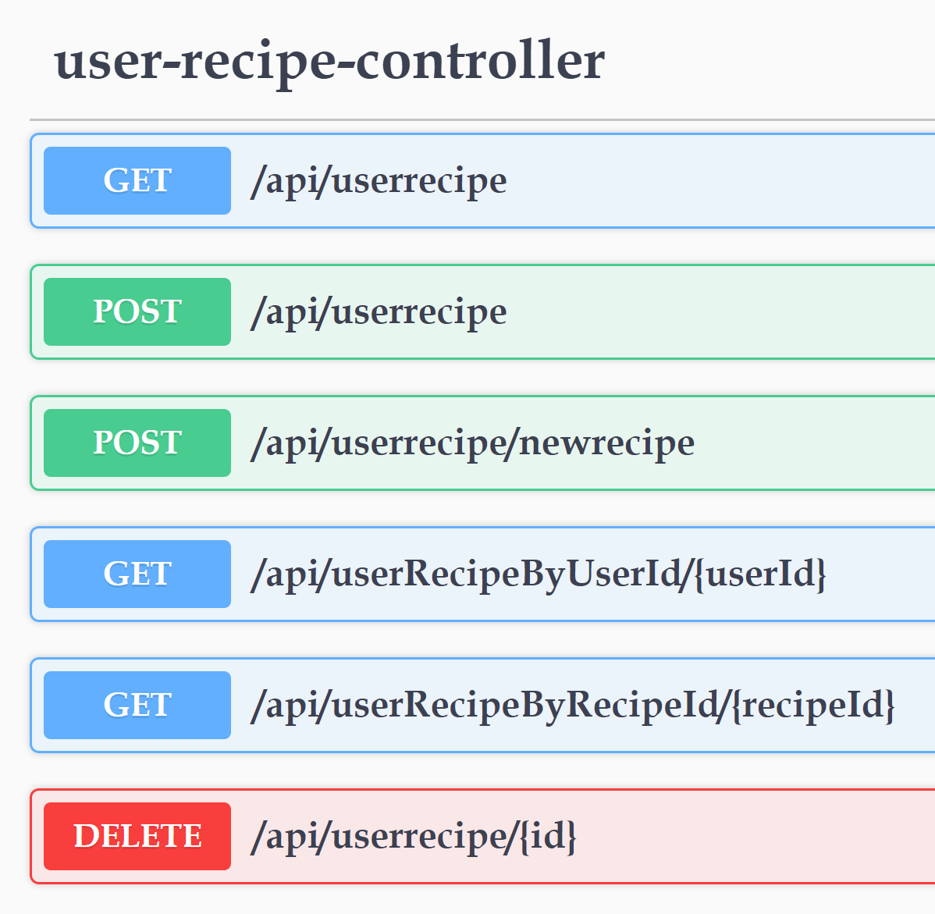
Swagger
Other than all of us having it, there’s a webpage we have that serves as the documentation for the website. It shows all of the possible API calls that were created and can be used. The part that was most useful and practical was that it was auto-generated.

Slide 12
DEMO TIME!

Slide 13
FUTURE SPRINT IDEAS
See recipe steps.
Uploading user images.
Access a given user’s posts.
Add a profile photo.
Add a “Like” button.
Clean up Github repository.
Tidy up endpoints.
Make it prettier!

Slide 14
Thanks!
ANY QUESTIONS?

